Slide 1







Capstone project
Julian shalash
03-11-2022

Slide 2



OUTLINE
Executive Summary
Introduction
Methodology
Results
Visualization – Charts
Dashboard
Discussion
Findings & Implications
Conclusion
Appendix

Slide 3

EXECUTIVE SUMMARY
The company name is AS
The company job is about IT solution
Its target is stay in the competition among other companies by analyzing data to help identify future skill requirements
It would to improve the programming languages and database choices
Its experience is about 8 years in IT solution

Slide 4

INTRODUCTION
There are several points about the project:
Understand the factors that effect on programming languages usage
What are the most programming languages used this year and next year
What are the most Database ﻿Worked With this year and next year
What are the most Platform Worked With this year and next year
What are the most Web Frame Worked With this year and next year

Slide 5

METHODOLOGY
Data was collected and cleaned then they was input into excel spreadsheets in csv format. The excel spreadsheet files were uploaded into IBM Cognos Dashboard. such as Language Worked With, were graphed and analyzed using the tools in IBM Cognos Dashboard. The focus of this analysis was to observe Programming Language Trends, Database Trends, the most popular web frames, the most popular platforms, and how the respondent count differed based upon gender, age, location, and education level.

Slide 6
RESULTS

Slide 7
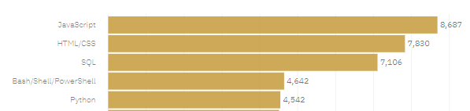
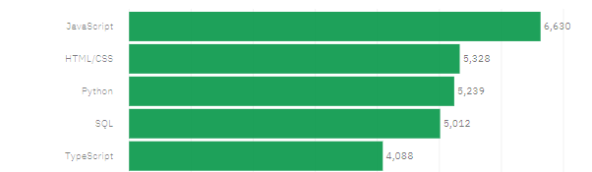
PROGRAMMING LANGUAGE TRENDS
Current Year
Next Year

Slide 8
PROGRAMMING LANGUAGE TRENDS - FINDINGS & IMPLICATIONS
Findings
The 5 Top languages this year in order:
JavaScript,Html/css,SQL,Bash/Shell/PowerShell,Python
The most popular language this
Year is JavaScript
The fifth popular language this
Year is TypeScript
There is a big difference between the first and fifth language this year
Implications
The 5 Top languages next year in order:
JavaScript,Html/css, Python ,SQL,TypeScript
The most and second popular language trend remain the same next year(JavaScript, Html/css)
Bash/Shell/PowerShell will not remain one of the top 5 language next year
Python will grow up to the third popular language next year

Slide 9
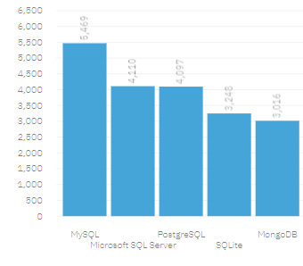
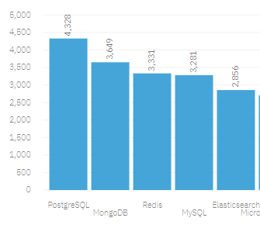
DATABASE TRENDS
Current Year
Next Year

Slide 10
DATABASE TRENDS - FINDINGS & IMPLICATIONS
Findings
The 5 Top Databases this year in order: MySQL,Microsoft SQL Server,PostgreSQL,SQLLite,MonogeDB
The most popular Database this
Year is MySQL
The fifth popular Database this
Year is TypeScript MonogeDB
There is a big difference between the first and fifth Database this year
Implications
The 5 Top Databases next year in order: PostgreSQL, MonogeDB, Redis,MySQL, Elasticsearch
The most popular Database will not stay the same next year it will be PostgreSQL and this means this Database will grow up from third database to the first
MySQL will go down to the third Database and MonogeDB will grow up to the second Database
Microsoft SQL Server and SQLLite will not stay among the top 5
Redis and Elasticsearch will grow up to the top 5 Databases

Slide 11

DASHBOARD
https://dataplatform.cloud.ibm.com/dashboards/83f9cc11-5533-474f-bb65-1faa87d26bc1/view/5719f2153fac699152d1e6e407cc2f507831710bb4bbd00384d17b495c687597a8684791c8274e0b8b14076afaef4650cc

Slide 12
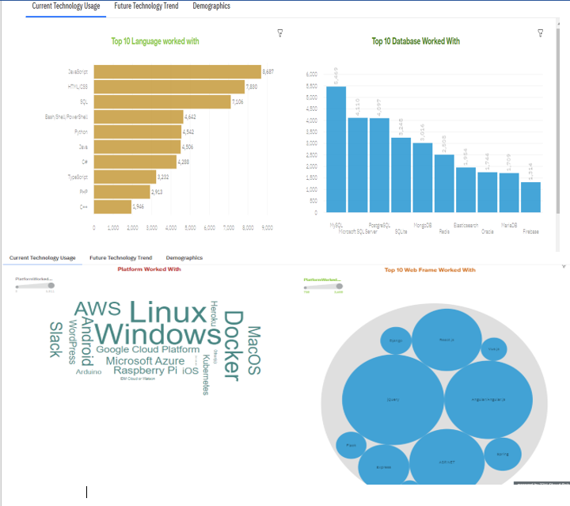
DASHBOARD TAB 1

Slide 13
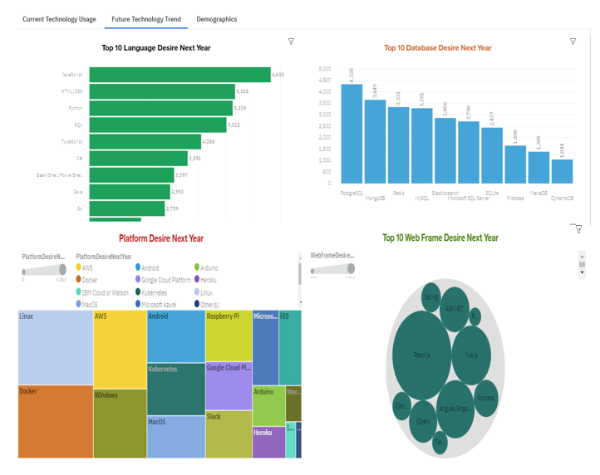
DASHBOARD TAB 2

Slide 14
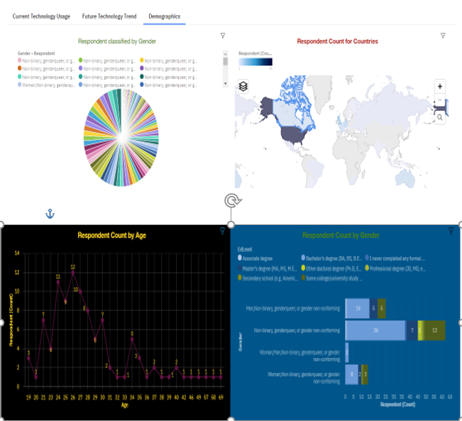
DASHBOARD TAB 3

Slide 15
DISCUSSION
We saw in this study there is a trend to the big data in the future so will be accreditation on the advanced programming language so we will see the difference in usage and results in the future

Slide 16
OVERALL FINDINGS & IMPLICATIONS
Findings
The usage in programming languages trend for advanced
The usage in Databases trend for non –relational databases
Implications
The companies and programmer go to the advanced languages that support the easy learning and more relation with the development in Labour market trends
The companies and programmer go to big data and warehouse because of the increase in interest of data

Slide 17

CONCLUSION
To collect the data we used accessing APIs and web scraping
The top programming language change by demand
The top Database change by demand

Slide 18

APPENDIX

Slide 19
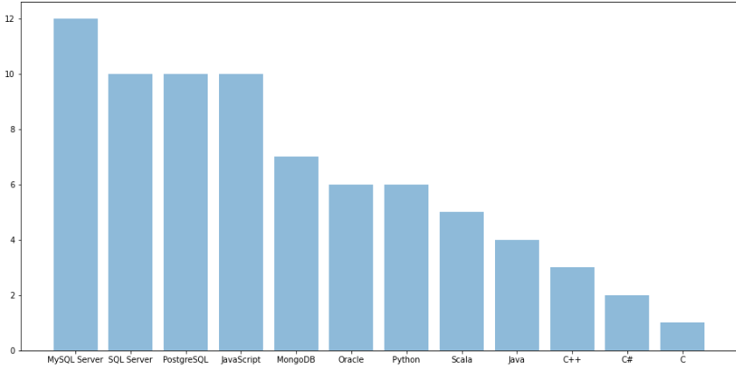
JOB POSTINGS

